Slide 1

Programming One (csc7050)
Aidan McGowan
Intro to control structures

Slide 2
Control structures
Sequential execution – statements are executed one after another
Transfer of control – when the next statement is not necessary the next executed.
GOTO statements in structured programming languages e.g. BASIC caused many problems
Sequence structure, Selection structure and Repetition structure – are the Control Statements

Slide 3
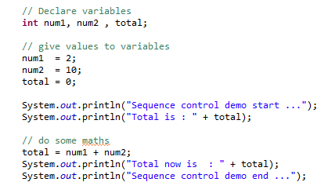
Sequence structure
Unless otherwise directed the computer executes Java statements one after the other in the order they are written…

Slide 4
Selection statements
Java has three section statements
if statement : single selection
if .. else statement : double selection
switch statement : multiple selection

Slide 5
Repetition (looping) statements
Java has three repetition statements
They enable a program to perform repeatedly an action(s) as long as a condition (loop control condition) is met.
while statement
do .. while statement
for statement

